Slide 1
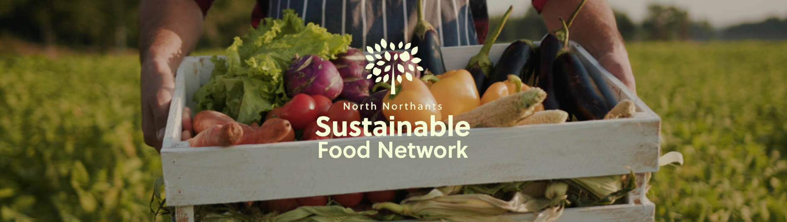






Slide 2
Background
Northamptonshire ACRE and Made in Northamptonshire set up the North Northants Sustainable Food Network in 2021.
Partners on the steering group also include Public Health, North Northants Council community team, voluntary sector organisations, the North Northamptonshire Foodbank Group and food producers.
Our original aim of the NNSFN is to make North Northamptonshire a sustainable food place and a member of the national network- we are now a full member!

Slide 3
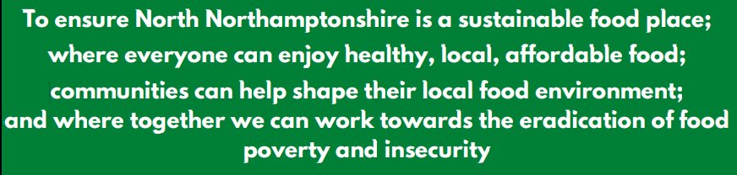
Our Mission:

Slide 4
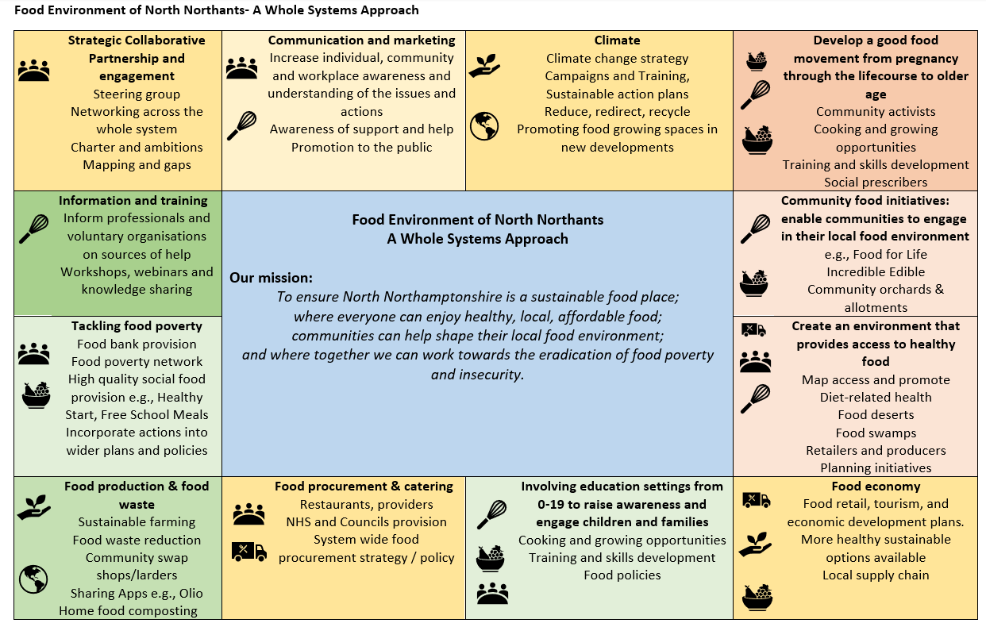

Slide 5
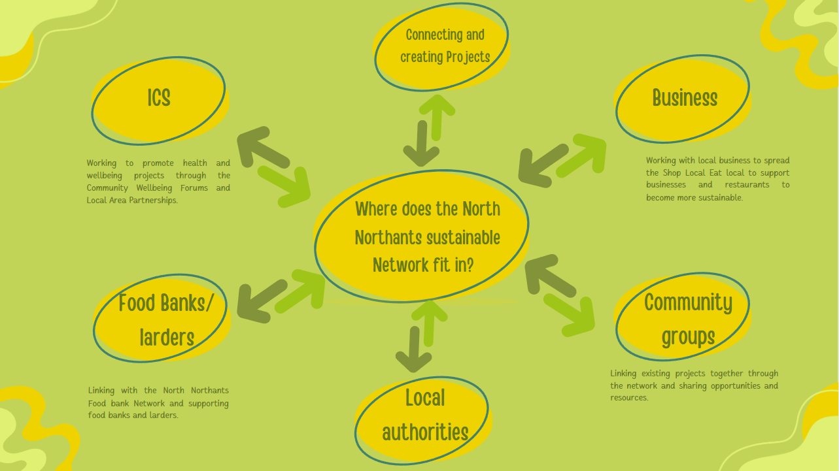
Where do we fit in the wider picture?

Slide 6
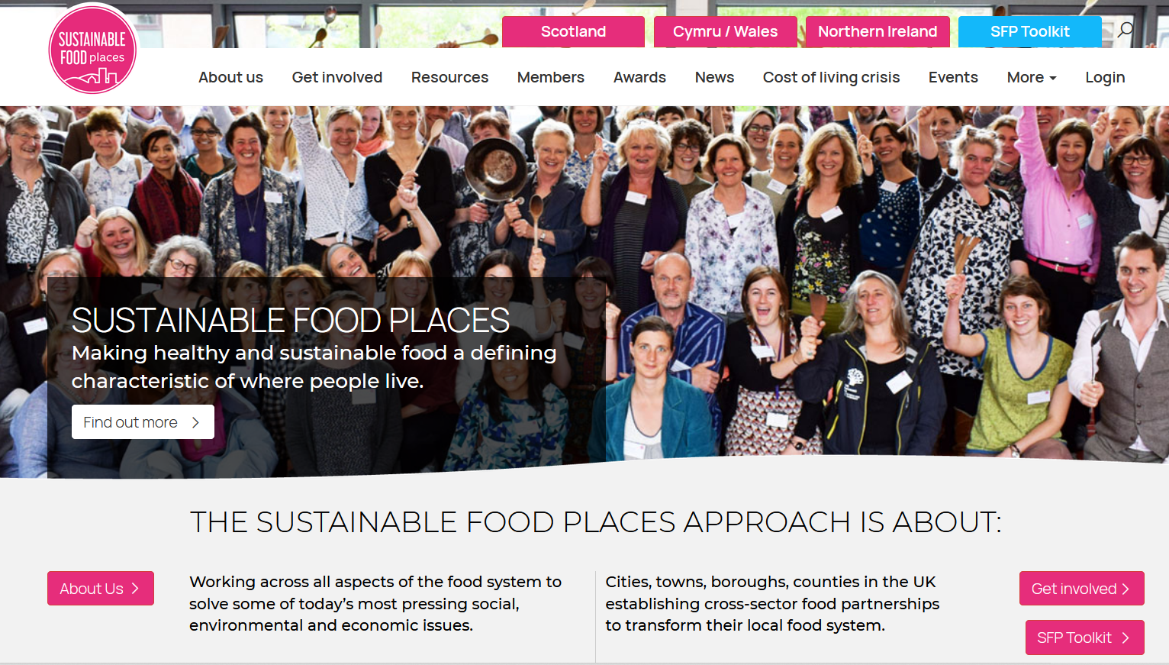
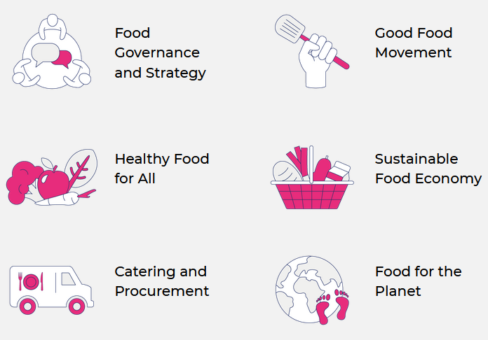
Sustainable Food Places
A national network of cross-sector partnerships working to transform local food systems
https://www.sustainablefoodplaces.org/

Slide 7
Full Circle Project
Applied to the UK Community Renewal Fund for Full Circle project
Received just over £106,000 to:
  Develop an online map of food producers, retailers, food banks, food larders and any other community organizations focused on food waste and poverty.
  Pilot 3 food apps and an assessment tool for retail and hospitality businesses, the apps helping businesses to reduce food waste and encourage sustainability.
  Research the food chain system in the north of the county, then produce a report highlighting any issues that were found with suggestions for how these might be rectified.
  Submit an application for North Northamptonshire to be become a registered Sustainable Food Place.
  Develop a website for the NNSFN

Slide 8
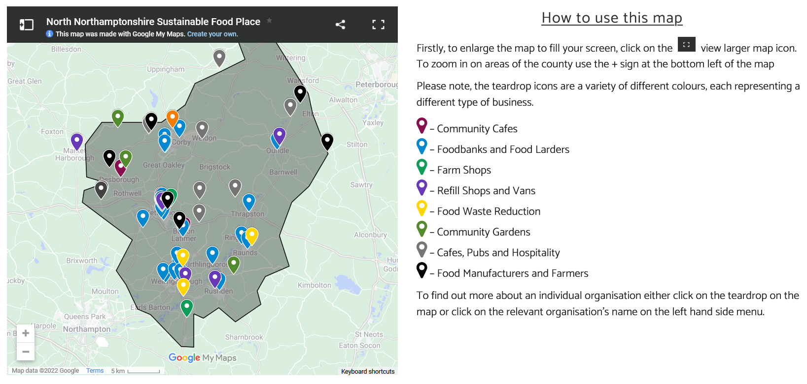

Slide 9
What have we achieved with CRF?
To date, 96 organisations and businesses have signed up to our map
Our newsletter reaches over 80 people and organisations
Our map has been viewed over 1300 times
Over 100 businesses have signed up to one or more of the apps
140 businesses engaged in knowledge transfer activity following support
North Northants is now a registered Sustainable Food Place and part of a national network: https://www.sustainablefoodplaces.org/
An evaluation of the project has been carried out by Focus Consultants and is available to download: https://nnsustainablefoodnetwork.co.uk/

Slide 10
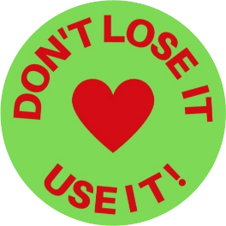
Plans for the next year
Buy local, eat local- Don’t use it, lose it campaign
Creating a growing network of community growing spaces in North Northants
Wider Communication and publicity for the network

Slide 11
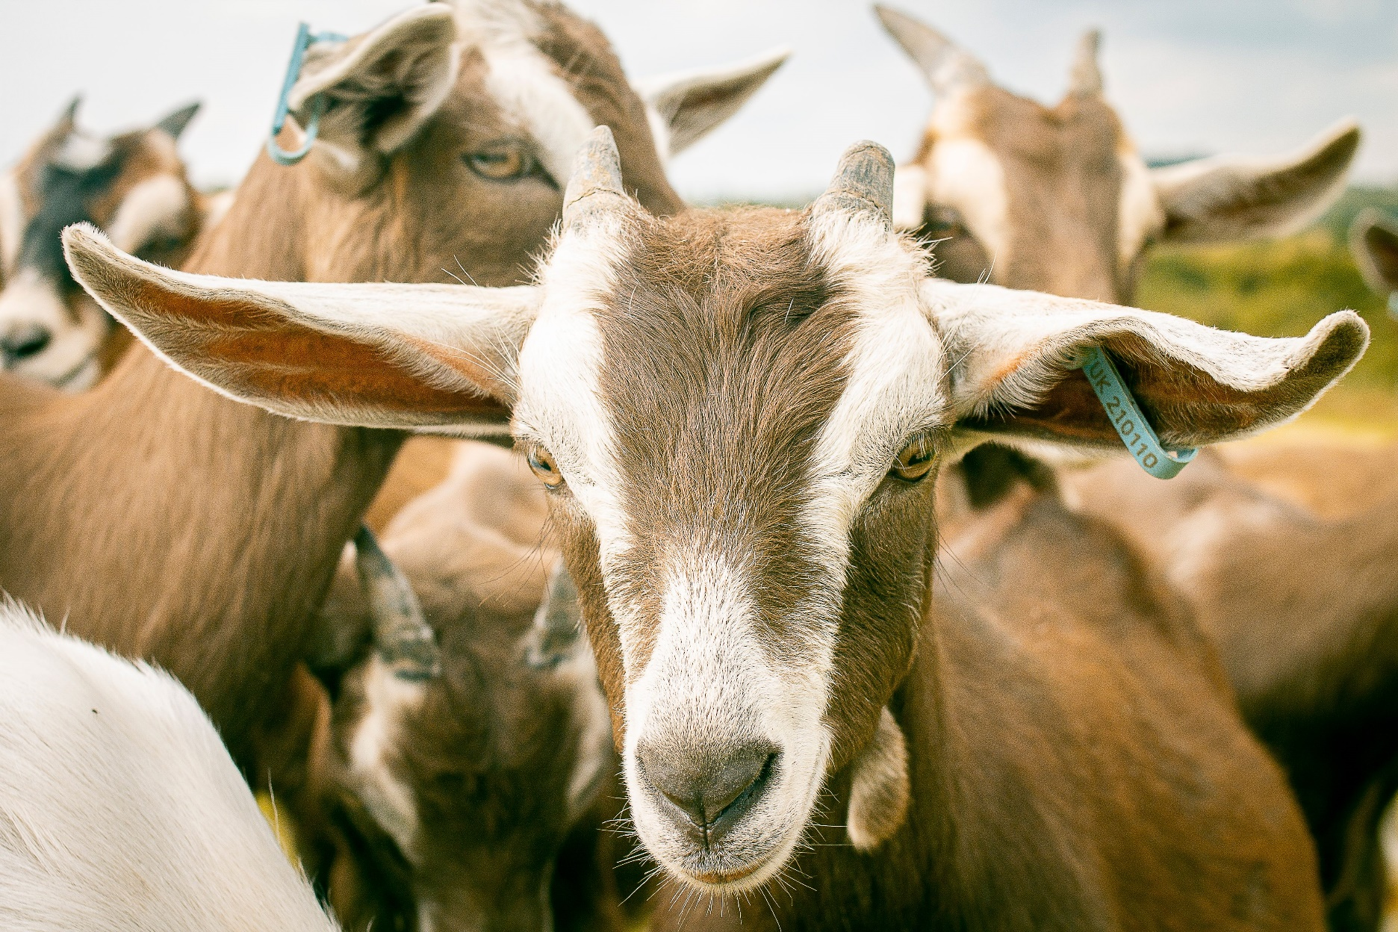
Case Study- Ganders Goat

Slide 12
How can you get involved?
Join
Join our steering group
Sign up
Sign up to our Charter
Sign up
Sign up to receive our newsletter: https://nnsustainablefoodnetwork.co.uk/
Follow
Follow us on social media (Facebook, Twitter & Linkedin)
Contact
Contact us for more details: enquiries@nnsustainablefoodnetwork.co.uk

Slide 13
Contact us
01604 765888
enquiries@nnsustainablefoodnetwork.co.uk
https://nnsustainablefoodnetwork.co.uk/
Follow us on Facebook, twitter and linkedin

